Slide 1
Spatial Sciences Institute
Resume Workshop
October 14, 2020

Slide 2
AGENDA
What makes a good resume?
Building blocks
Style tips and tricks
Additional resources
Question & Answer
Resume Workshop| 2
SECTION TITLE | 2

Slide 3
What makes a good resume?
A resume provides details on your educational and professional history and competencies
Your opportunity to inform the employer why you are a good fit for the position
Resume Workshop | 3
SECTION TITLE | 2
Notes:
Resume connects the dots between things you have done or are doing to details in job description or what you know of the position. Just like you customize your outfit based on where you are going, you customize the resume based on the position and the requirements of that role. It is NOT a place to list entire work history or your hobbies or high school achievements UNLESS those things are relevant to the position

Slide 4
What makes a good resume?
Matches keywords in the job description
Clearly informs the viewer how your experiences match their needs
Resume Workshop | 4
SECTION TITLE | 2
Notes:
Resume screening software filters resumes for keywords. It’s all about showing the employer why you are good for THIS job in THIS organization.

Slide 5
Building Blocks
Includes your name and contact information
Does not require a photo
Three components
Education (Post-secondary education only)
Work/research experience
Relevant skills and additional information
Layout
White or off-white paper
(Usually) 1 page and 12 pt. font
Utilize white space effectively
Resume Workshop | 5
SECTION TITLE | 2
Notes:
American resumes do not require a photo and in fact should NOT include one unless otherwise requested by employer. Make sure the aesthetics of the document are correct – white or off white paper only, not too long and use legible font size. Don’t try to cram lots of information into small amount of space but be mindful of leaving lots of blank spaces

Slide 6
Building Blocks
Education
Start with most recent education first
Spell out names of schools and degrees
Resume Workshop | 6
SECTION TITLE | 2
Notes:
List education reverse chronological order – start with most recent first. Don’t use abbreviations and spell out all names of degrees and schools. Note, it is not a BachelorS of Science or MasterS of Art, it’s Bachelor of Science, Master of Art. You usually do not need to include GPA (unless it’s very high) and can either list honors here or under an “additional information” section later on in the resume.

Slide 7
Building Blocks
Work/research experience
Start with most recent first
Use a heading for each position that includes name and location of organization/research group, your title, and dates that you were employed
Information about your positions should NOT be a list of tasks but should communicate your accomplishments
Be specific and use amounts whenever possible
Resume Workshop | 7
SECTION TITLE | 2
Notes:
List work or research experience with the most recent at the top. If you don’t have any work experience, you can list research done in your classes. Think of the big projects you’ve done or going to do and frame those as research experiences

Slide 8
Building Blocks
Activity-based statement: “served as GIS intern”
Task-based statement: “built a database”
Skills-based Impact Statements
“Created a web mapping application through ArcGIS that improved emergency response time by 10%”
-Susan Kamei, 2017
Resume Workshop | 8
SECTION TITLE | 2
Notes:
The way you phrase each point related to your positions should be intentional and designed to make the most impact

Slide 9
Building Blocks
TASK you did =
Created a web mapping app
SKILL you used to complete the task =
through ArcGIS
IMPACT of your work =
improved emergency response time by 10%
-Susan Kamei, 2017
Resume Workshop | 9
SECTION TITLE | 2

Slide 10
Building Blocks
Example 1
Spatial Sciences Institute Los Angeles, CA
Student Worker May 2019 – Current
Maintain student records
Help with events
Perform tasks as they are assigned
Resume Workshop | 10
SECTION TITLE | 2
Notes:
Basic examples that list job duties and don’t tell us impact. The employer will see many resumes that have this information included.

Slide 11
Building Blocks
Example 2
Spatial Sciences Institute Los Angeles, CA
Student Worker May 2019 – Current
Utilize student database to track internship and employment opportunities for 500+ students and alumni, leading to 20% increase in student internship placement
Co-lead the organization and execution of annual development reception for 150 guests at off-site location
Identify and implement strategies for increased efficiency in day-to-day projects and routines
Resume Workshop | 11
SECTION TITLE | 2
Notes:
Specific information gives us a sense of the scale you’re working with as well as impact your efforts have on operations. DON’T LIE OR OVEREXAGGERATE but be conscious of the kinds of verbs you use and construction of the bullet points. You can offer additional details during the interview if needed.

Slide 12
Building Blocks
Additional information and relevant skills
Usually at the bottom of the resume
Includes professional and academic awards, honors, publications, licenses, organizational membership, conference presentations, software and hardware fluencies, foreign language skills, etc.
Resume Workshop | 12
SECTION TITLE | 2
Notes:
The additional information and relevant skills section is like your bag of tricks. It’s all the OTHER stuff that is relevant to the position that wasn’t not spelled out in the work/research history section of the resume. It should include skills and experiences you’ve acquired both in the class and through extracurricular activities but should NOT be a laundry list of everything you’ve ever done. It should also not include skills that are inherently expected in college-educated students (fluent in English, expert in Microsoft Word, etc.)

Slide 13
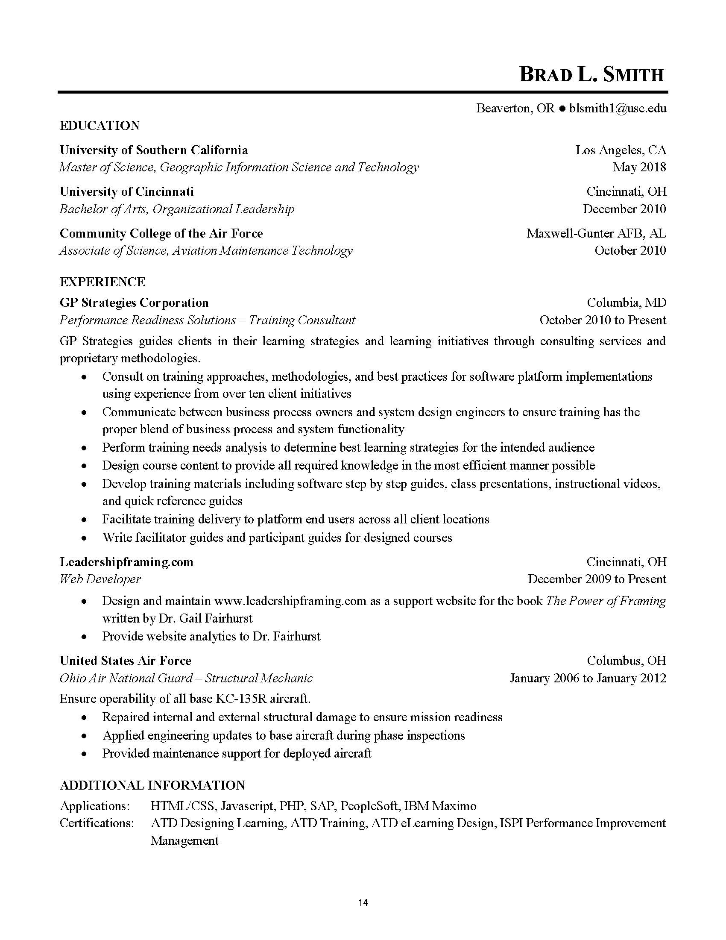
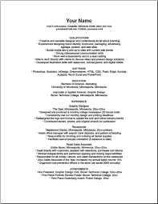
Building Blocks
Be conscious about the layout of your resume
Resume Workshop | 13
SECTION TITLE | 2
Notes:
Use legible font, pay attention to indentation and both sides f margins, be consistent in layout, don’t try to cram too much onto the sheet

Slide 14
Style tips and tricks
Consistency is key!
Don’t change the voice of the resume
“I was responsible for…”
“Responsible for…”
Use the same structure for each entry
If you list name of employer then position title, don’t reverse it on the next entry
Grammar and spelling count!
No typos
Em dashes and hyphens are NOT interchangeable
Resume Workshop | 14
SECTION TITLE | 2

Slide 15
Style tips and tricks
Use the “additional information” section wisely!
Include concepts, materials, skills you are learning in class now
Be sure to list all software platforms and programming languages
Use discretion in listing awards, honors, and accomplishments
Use facts, not opinions and be concise
Resume Workshop | 15
SECTION TITLE | 2
Notes:
It is important to highlight your accomplishments, honors, and awards in this section but use discretion. A second place finish in the high school talent show, while impressive, is not necessarily what a future employer is looking for. Don’t editorialize – “Standout student on a project” or “Contributed the best work”

Slide 16
Additional Resources
USC Career Center
Resume workshops
Blog posts: https://careers.usc.edu/students/write-a-resume/
One-on-One advising
STU 110
213-740-9111
careers@usc.edu
Ask for help!
Ken Watson (watsonke@usc.edu), Dairon Caro (dcaro@usc.edu), Susan Kamei (kamei@usc.edu), or your faculty
Resume Workshop | 16
SECTION TITLE | 2
Notes:
Career Center has a ton of information, not just on resumes but on interviewing and finding opportunities. Use them!

Slide 17
Questions?
Resume Workshop | 17
SECTION TITLE | 2

